Slide 1
Integrating Public Policy Resources Into Markets (in 3 RTOs): NEPOOL’s IMAPP Initiative Integrating Markets And Public Policy
Joel Gordon Chairman, New England Power Pool Energy Policy Roundtable in PJM December 1, 2016

Slide 2
The New England Power Pool (NEPOOL)
Formed in 1971 to address reliability and coordinated dispatch.
Over 450 members across six governance sectors
NEPOOL’s Mission: “To create and sustain open, non-discriminatory, competitive, unbundled markets for energy, capacity and ancillary services that are balanced between buyers and sellers.”
Notes:
Restructured in late 1990’s to conform with industry’s move away from a vertically integrated cost-based rates

Slide 3
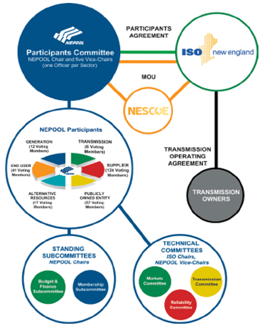
NEPOOL Stakeholder Process
NEPOOL is THE stakeholder voting organization to advise on all matters relating to the competitive wholesale market rules and transmission tariff design.
Designed to maximize consensus among stakeholders

Slide 4
Genesis of IMAPP
Broad acknowledgement that current markets were not designed to achieve state energy policies.
Growing recognition of states’ need to achieve legislatively mandated targets.

Slide 5
Perspectives of the Gaps – Buy Side
Public Policy Perspective:
Markets not delivering desired outcomes.
Not designed to accomplish states’ clean/renewable policies
Market protections (MOPR) can prevent full value for new state policy resources.
Need to ensure that consumers get what they pay for at a reasonable cost.

Slide 6
Perspectives of the Gaps – Sell Side
Competitive Supplier/Merchant Perspective:
State solicitations result in out-of-market procurement and impact competitive outcomes:
Suppresses prices below competitive levels.
Segments markets and reduces size and liquidly.
Greater need to rely on market protections (MOPR) to ensure proper price formation.
Notes:
Undermines sustainability of markets long term

Slide 7
Bridging the Divide - IMAPP
A NEPOOL initiative to consider changes to the existing wholesale competitive market design that will not only ensure reliability of the electric system through competitive wholesale markets, but will do so while at the same time achieving the public policy goals of the New England states.

Slide 8
IMAPP Challenges
I. Defining what is “Public Policy.”
Markets work best with well defined products.
II. Deciding how much “Public Policy” to procure.
States’ requirements drive procurements.
III. Agreeing on who pays.
Policies not necessarily valued equally across states.
Notes:
A critical question is whether the markets should accommodate state policies or whether state policies should be achieved directly through the centralized markets administered by ISO-NE.

Slide 9
IMAPP Proposals
Carbon Pricing in the Energy Market
Integrates carbon costs in energy offers. Adder $ returned by emitters.
Forward Clean Energy Market (FCEM)
Forward market for clean energy.
Carbon-Integrated Forward Capacity Market (FCM-C)
Co-optimized zero emission credit (ZEC) with the existing Forward Capacity Market (FCM)
FCM Two-Tiered Pricing Construct
Protects market players from price suppression while accommodating participation of state supported projects.
Notes:
FCEM – designed to support both existing and new resources.

Slide 10
Carbon Adder Proposal
Incorporates a cost of carbon into energy offers.
Technology neutral.
Appropriate signals for supply and demand.
Translates carbon goals into transparent price.
Adder collected from emitters.
Redistributed per agreement (see Nov 10 Cost Allocation proposal)
Adder determined by states based upon goals.
Can be adjusted based upon outcomes.
Notes:
Gold Standard for Economists
“best design, but probably least likely to be implemented.
Cost Allocation Proposal:
Compare state goals against contracted resources to determine shortfall. Resources with PPA not eligible to keep LMP adder. Only non-emitting, non contracted units keep the adder in LMP.

Slide 11
Carbon Adder Impacts
Proposal at $32 ton (with RGGI soft cap of $10) equals social cost of carbon.
Sufficient to keep nukes in-market.
Recognized as not high enough to incent new renewables stand alone, but...
Reduces other program costs(RECs, contracts).
Enhances efficiency of other backstop proposals.

Slide 12
Carbon Adder Impacts

Slide 13
Forward Clean Energy Market (FCEM)
Facilitates new renewable entry and compensates existing, non-contracted renewables.
Predictable market structure
High quality revenue stream
Standardized & repeatable
Transparent pricing drives competition.
Procures commitments ≈3.5 yrs forward to produce energy that would generate Class 1 RECs.
Physical resources specific, but tradable.
Longer term rate-lock period.
Auction clears in $/MWh
$ collected from entities with RPS requirements, separate from energy & capacity.

Slide 14
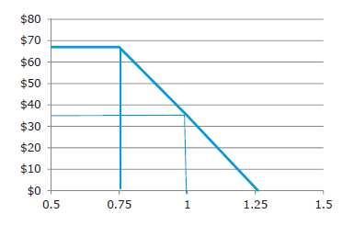
FCEM
Limited to Class I resources.
Already defined throughout NE.
Procurement targets is aggregate Class I Rec Requirements.
Uses a demand curve based on
REC values and the Alternative
Compliance Payment (ACP).
Notes:
✓i) they are already defined in the six states, with clear eligibility
and numerical requirements;
✓ii) they are generally interchangeable within (and beyond) the
region; and
✓ iii) they trade in a spot/prompt market for RPS compliance,
providing a price and mechanism for settling imbalances in
forward positions

Slide 15
Carbon Integrated Forward Capacity Market (FCM-C)
Supports clean energy investments over the longer term at least societal cost.
No locational differentiation, trading allowed.
Complements (and advocates) carbon adder proposal.
Technology neutral – nukes and imports eligible.
FCM-C and CO2 pricing would retain existing clean resources as long as they are the most cost-effective resources.
Proposal claims to reduce energy and capacity costs for all participating and non-participating states.

Slide 16
Carbon Integrated Forward Capacity Market (FCM-C)
Two supply curves for two separate products in a single auction:
Capacity Product: Current definition of capacity MW; cleared resources acquire a CSO.
New Product: Zero Emission Credits (ZECs) for producing MWhs from non‐emitting resources.
ZEC‐eligible resources offer a single price (for both commodities) sufficient to meet their revenue requirement.
Delivery is MWHs in the delivery year.
ISO simultaneously clears these offers in a single auction using least‐cost combination of the two products.
New resources eligible for 7 year rate lock, not available to existing.

Slide 17
Two Tiered Forward Capacity Market
Enables states to pursue policies (contracts) independent of the markets.
Protects price formation in the capacity market.
Develops a “but-for” price for existing resources.
Replaces the 200MW/600MW Renewable Energy Technology Exemption
Allows all state sponsored projects to participate as capacity resources.

Slide 18
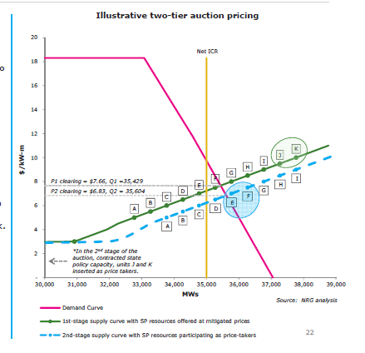
Mechanics of Two Tiered Pricing
Full competitive outcome (green & pink): $7.66/kw-mo
Qty: 35,429 MW ➔ Total Mkt Cost: $3.257 Bn.
Add 1,000MW State sponsored capacity shifts curve
to the right (blue line): $6.83/kw-mo.
Qty: 35,604 MW ➔ Total Mkt Cost: $2.918 B n.
Price Suppression: $339 million.
In-Between Capacity – capacity that cleared the first
auction, but was pushed out in the second
Proposal is to pro-rate MW Quantities to equate to
same all-in cost of the competitive market outcome.
Notes:
Total mkt cost – buy all in between:
(P1 X Q1) + (P2 x Qsp), or
($7.66/kw-mo x 35,429MW) +
$6.83/kW-mo x 1,000MW) = $3,339 Million
Total Mkt cost – buy no in between
(P1 x (Q1 – Qin-between)) + (P2 x Qsp),
or
$7.66/kW-mo x (35,429 - 825)MW +
$6.83/kW-mo x 1,000MW = $3,263 milliono

Slide 19
IMAPP Status
At least two additional meetings scheduled in 2017
Continuing discussions to find acceptable solutions
Indicative NEPOOL vote targeted for late Q1/solutions
IMAPP: http://nepool.com/IMAPP.php

